Slide 1

BACHELOR OF TECHNOLOGY
IN
Artificial Intelligence and Machine Learning
Project Guide : Prof.Balaiah Batch Number: 17
Batch Names & Roll Number:-
V.Durga Mahesh 2111CS020127
P.Durgashashinadh 2111CS020128
B.Esha Tanmai 2111CS020129
E.Eshwar Sai Pranay 2111CS020130
Fardeena Thoufiya 2111CS020131
Fouziya Thabassum Syed 2111CS020132

Slide 2
CONTENTS
Introduction – (Number of Slides 1 or 2 Slides)
Project Title
Abstract
Limitations (OPTIONAL)
Existing System & Proposed System (1 Slide)
Modules (1 or 2 Slides)
Architecture of Project Diagram ( 1 Slide)
DFD’s/E-R Diagram/UML/Any project diagram (1 or 2) Slides

Slide 3
INTRODUCTION
Sentimental Analysis of Product Reviews
Sentiments are feelings, opinions, emotions, likes/dislikes,good/bad
Sentiment Analysis is a Natural Language Processing and Information Extraction task that aims to obtain writer's feelings expressed in positive or negative comments, questions and requests, by analyzing a large numbers of documents.
Sentiment Analysis is a study of human behavior in which we extract user opinion and emotion from plain text.Sentiment Analysis is also known as Opinion Mining.
It is a task of identifying whether the opinion expressed in a text is positive or negative.
Automatically extracting opinions, emotions and sentiments in text. Language-independent technology that understand the meaning of the text
It identifies the opinion or attitude that a person has towards a topic or an object.

Slide 4
ABSTRACT
Sentiment analysis is a technique used to classify the polarity of sentiments and opinions expressed in text data. This classification may be binary, distinguishing between positive and negative sentiments, or multiple, identifying emotions such as happiness, anger, sadness, and disgust. This project aims to develop a Python-based sentiment analysis system using machine learning techniques. The system will analyze text data to determine sentiment scores, which can be binary or multiple. The system will be trained on a labeled dataset and can be used for social media monitoring, customer feedback analysis, and market research. The project provides an opportunity to learn about machine learning techniques, including text preprocessing, feature extraction, and model selection. In summary, this project aims to develop a sentiment analysis system using Python, which can classify the polarity of sentiments and opinions expressed in text data accurately. It will leverage machine learning techniques and can be applied to various applications, including social media monitoring, customer feedback analysis, and market research

Slide 5
TOOLS USED IN WEBSITE
HTML,CSS, JAVASCRIPT,BOOTSTRAP are the Frontend Tools used to develop the front end part of the website , SQL,PHP,DJANGO is used for the backend for the website. And we need to implement some Useful Python Libraries to perform sentimental analysis such as Natural Language Toolkit [NLTK] (used for processing and provides various tools for text processing and sentiment analysis) Scikit-learn(It is a machine learning library in Python that provides several algorithms for text classification and sentiment analysis),TextBlob(It is a Python library for processing textual data and provides a simple API for sentiment analysis),VADER [Valence Aware Dictionary and Entiment Reasoner] (It is a rule-based sentiment analysis tool that provides a pre-built sentiment lexicon for sentiment analysis),Gensim (It is a Python library for topic modeling and provides various algorithms for sentiment analysis and text classification),TensorFlow(It is a popular machine learning library for building and training deep learning models and can be used for sentiment analysis),Keras(It is a high-level neural network API and can be used for sentiment analysis and text classification tasks). These tools and libraries can be used for various tasks involved in sentiment analysis projects, such as data preprocessing, feature extraction, model selection, and evaluation

Slide 6
EXISTING SYSTEM
Yes, The Sentiment Analysis Already exists in our Day to Day Life.
Example:-
Social media monitoring: Sentiment analysis can be used to monitor social media platforms like Twitter and Facebook to understand the public's opinion about a particular brand, product, or event.
Customer feedback analysis: Sentiment analysis used to analyze customer feedback in the form of reviews, surveys, and feedback forms to understand their satisfaction levels and identify areas for improvement.
Market research: Sentiment analysis used in market research to understand consumer behavior and identify trends and patterns in their opinions and preferences.
Brand reputation management: Sentiment analysis used to monitor a brand's reputation and identify negative sentiment or potential PR crises.
Political analysis: Sentiment analysis used to analyze public opinion on political candidates, policies, and events.
Financial analysis: Sentiment analysis used to analyze market sentiment and predict stock prices and other financial indicators.
Healthcare analysis: Sentiment analysis used to analyze patient feedback and improve healthcare services and patient satisfaction

Slide 7
PROPOSED SYSTEM
So we are going to test the sentiment analysis of products reviews, we are going to test the sentiment analysis of the reviews given by the customers to the products which are sold in a ecommerce website
Rule-based system: This approach involves creating a set of rules that can classify the sentiment of the text. The rules can be based on specific keywords or patterns that are commonly associated with positive or negative sentiment.
Machine learning-based system: This approach involves training a machine learning model on a dataset of product reviews that have been labeled with their corresponding sentiment. The model can then be used to classify new reviews based on their sentiment.
Hybrid system: This approach combines both rule-based and machine learning-based approaches to improve the accuracy of the sentiment analysis. The rule-based system can be used as a pre-processing step to identify the sentiment of the text, which can then be used to train a machine learning model.
Aspect-based sentiment analysis: This approach focuses on analyzing the sentiment of specific aspects of the product, such as the quality of the product, the customer service, or the price. This approach can provide more detailed insights into how customers feel about different aspects of the product.
Deep learning-based system: This approach involves using deep neural networks to perform sentiment analysis on product reviews. This approach has been shown to achieve state-of-the-art performance on various sentiment analysis tasks.

Slide 8
MODULES
User interface: This module will provide a user-friendly interface for users to input text and view the sentiment analysis results.
Sentimental Analysis Model: This module will use machine learning algorithms to analyze the sentiment of the text.
Database: This module will store the user data and sentiment analysis results.
Reporting: This module will generate reports and visualizations of sentiment analysis results.

Slide 9
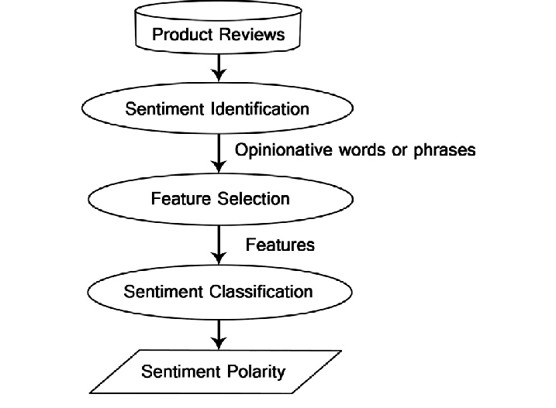


Architecture Diagrams

Slide 10
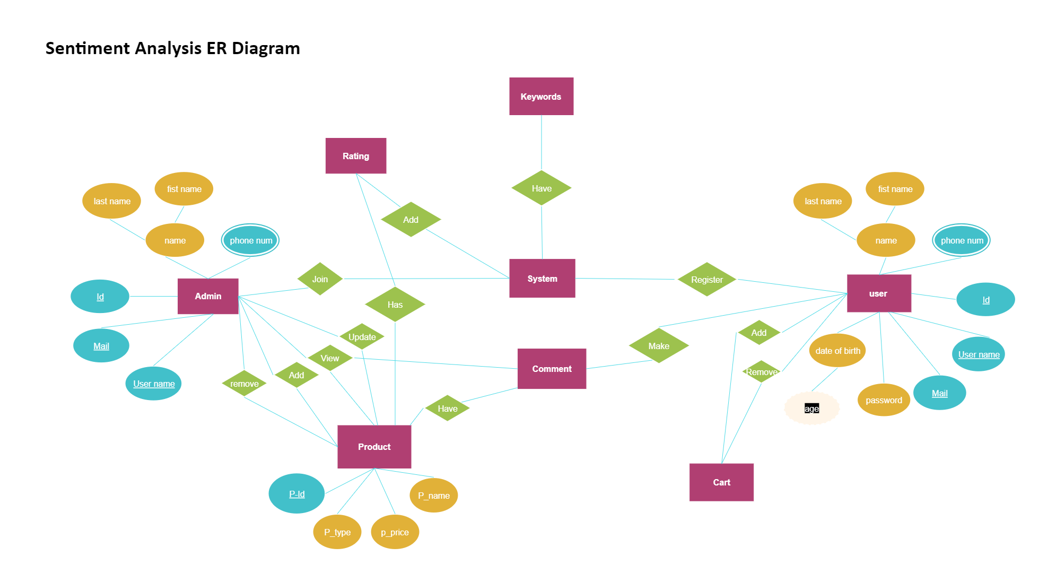









ER-Diagrams

Slide 11
Data Sets Description:

Slide 12
Algorithm & Methods:
Majorly 4 types of supervised machine learning algorithms are being using in implementing the project. They are
Rule Based Methods
Machine Learning Algorithm
Deep Learning Algorithm
Ensemble Methods
Lexicon Based Methods

Slide 13
Steps For Model Evaluation:
Data Preprocessing: Preprocess the data by removing stopwords, punctuation, special characters, and lowercasing the text. The data should be cleaned and prepared in a format that is suitable for the machine learning model. Split the Data: Split the data into training, validation, and testing sets. The training set is used to train the model, the validation set is used to tune the hyperparameters, and the testing set is used to evaluate the final model.
Feature Extraction: Extract features from the text data using techniques such as Bag of Words, TF-IDF, and Word Embeddings. This step involves converting the text data into a numerical representation that can be fed into the machine learning model.
Train the Model: Train the machine learning model using the training set. There are various machine learning algorithms that can be used, such as Naive Bayes, Support Vector Machines, and Neural Networks.
Validate the Model: Validate the model by evaluating its performance on the validation set. This step involves tuning the hyperparameters to achieve the best possible performance.
Test the Model: Test the final model on the testing set to evaluate its performance. This step involves calculating various metrics such as accuracy, precision, recall, and F1 score.
Interpret the Results: Interpret the results obtained from the testing set and draw conclusions. The results should be analyzed to determine if the model is performing well or if further improvements are needed.
Iterate: Iterate over the above steps until the desired level of performance is achieved. This step may involve changing the feature extraction techniques, machine learning algorithms, or hyperparameters to achieve better results

Slide 14
Thank you

